Slide 1
CSE 110
Aminul Huq
aminul.huq@bracu.ac.bd

Slide 2
Class & Objects
An object represents an entity in the real world that can be distinctly identified.
For example, a student, a desk, a circle, a button, and even a loan can all be viewed as objects. An object has a unique identity, state, and behavior.
■ The state of an object (also known as its properties or attributes) is represented by data fields with their current values. A circle object, for example, has a data field radius, which is the property that characterizes a circle. A rectangle object has data fields width and height, which are the properties that characterize a rectangle.
■ The behavior of an object (also known as its actions) is defined by methods. To invoke a method on an object is to ask the object to perform an action. For example, you may define a method named getArea() for circle objects. A circle object may invoke getArea() to return its area.

Slide 3
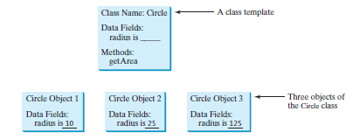

Slide 4
A Simple Class
class Box {
double width;
double height;
double depth;
}
To actually create a Box object, you will use a statement like the following:
Box mybox = new Box(); // create a Box object called mybox

Slide 5
For example, to assign the width variable of mybox the value 100, you would use the following statement:
mybox.width = 100;

Slide 6
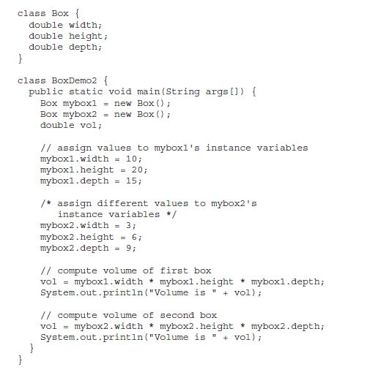
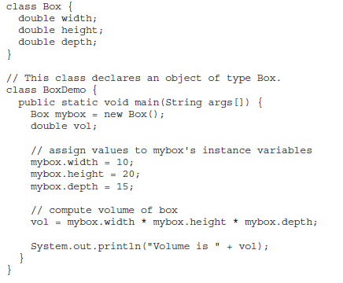

Slide 7
Declaring Objects
obtaining objects of a class is a two-step process.
First, you must declare a variable of the class type. This variable does not define an object. Instead, it is simply a variable that can refer to an object.
Second, you must acquire an actual, physical copy of the object and assign it to that variable. You can do this using the new operator.
The new operator dynamically allocates (that is, allocates at run time) memory for an object and returns a reference to it. This reference is, more or less, the address in memory of the object allocated by new. This reference is then stored in the variable.

Slide 8
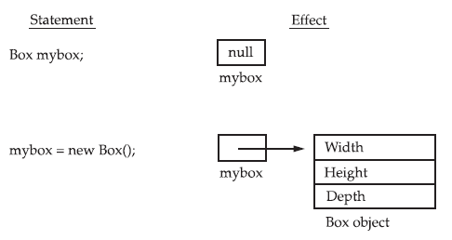
Box mybox; // declare reference to object
mybox = new Box(); // allocate a Box object

Slide 9
Assigning Object Reference Variables
Object reference variables act differently than you might expect when an assignment takes place. For example, what do you think the following fragment does?
Box b1 = new Box();
Box b2 = b1;
You might think that b2 is being assigned a reference to a copy of the object referred to by b1. That is, you might think that b1 and b2 refer to separate and distinct objects. However, this would be wrong. Instead, after this fragment executes, b1 and b2 will both refer to thesame object.

Slide 10
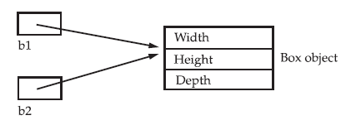

Slide 11
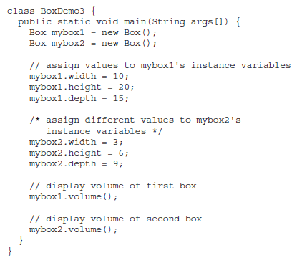
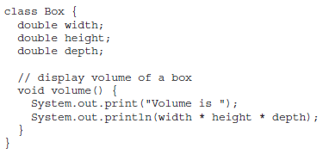
Adding a Method to the Box Class

Slide 12
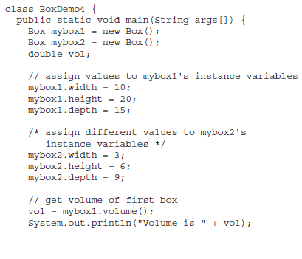
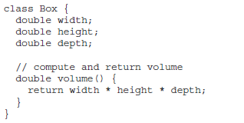
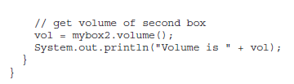

Slide 13
Constructors
A constructor initializes an object immediately upon creation. It has the same name as the class in which it resides and is syntactically similar to a method.
Once defined, the constructor is automatically called immediately after the object is created, before the new operator completes.
Constructors look a little strange because they have no return type, not even void.
This is because the implicit return type of a class’ constructor is the class type itself

Slide 14
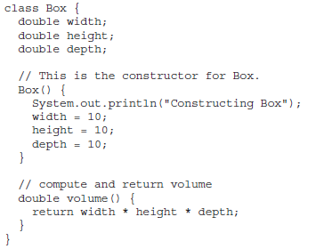
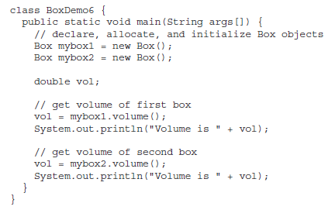


Slide 15
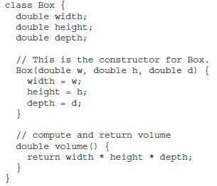
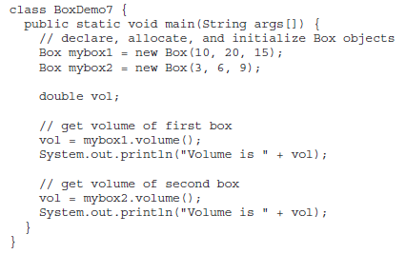

Parameterized Constructors

